Slide 1
JAVASCRIPT SYMBOL

Slide 2
JavaScript Symbol
The JavaScript Symbol is a function that is used to identify the object properties

Slide 3
Points to remember
A Symbol() method always return a unique value
A symbol value may be used as an identifier for object properties
Symbols are immutable, just like numbers or strings
Symbols cannot be typecasted to primitive data types

Slide 4
Syntax
Symbol([description])
description: It is optional. We can pass string as an argument

Slide 5
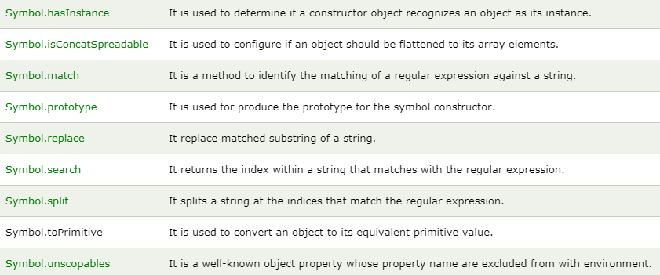
JavaScript Symbol Property

Slide 6
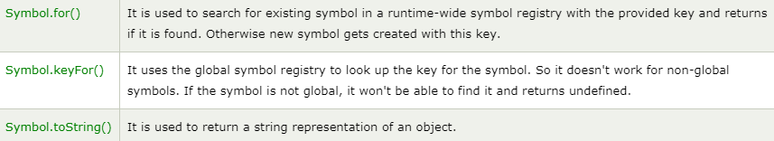
JavaScript Symbol Methods

